Slide 1


Eric Vinciquarra
6/24/2022

Slide 2

Outline
Executive Summary – Page 3
Introduction – Page 4
Methodology – Page 5
Results
Conclusion
Appendix

Slide 3
Executive Summary
Executive Summary
Data collection methodology:
Perform data wrangling
Perform exploratory data analysis (EDA) using visualization and SQL
Perform interactive visual analytics using Folium and Plotly Dash
Perform predictive analysis using classification models
Summary of methodologies
Summary of all results

Slide 4
Introduction
The possibility of space travel being available to the public has been proven. It is now important to provide space travel to the public for a variety of interests. Space Y is determined to provide this service to our consumers.
SpaceX is the one of the most successful companies for providing space travel. We need to analyze the available data on SpaceX to determine how feasible it is for Space Y to become a successful venture. To do this, we will primarily focus on the cost of utilizing rockets designed for space travel.
Questions to ask and find the answers to include, but are not limited to, the following…
Why was SpaceX successful?
How much does it cost SpaceX to launch its rockets?
What rocket types and launch sites are favorable for successful launches?

Slide 5

Section 1

Slide 6
Methodology
Executive Summary
Data collection methodology
Perform data wrangling
Perform exploratory data analysis (EDA) using visualization and SQL
Perform interactive visual analytics using Folium and Plotly Dash
Perform predictive analysis using classification models

Slide 7
Data Collection
Data was collected by using SpaceX’s REST API. The API was used to extract data and define to data frames for the data to be analyzed.
Data was also collected using web scraping techniques with the BeautifulSoup function.

Slide 8
Data Collection – SpaceX API
Data collection process using the SpaceX API.
Created helper functions in order to use the API effectively.
Requested the data from the SpaceX API via URL.
Utilized the API again in order to collect data based on a rocket’s Identification.
Used .json() and .json_normalize() to decode the collected data and convert into a Pandas data frame.
Appointed the newly collected data to lists once again.
Created a final data frame containing all the data to be analyzed.
https://github.com/ericsvince/Coursera/blob/a04b1cc5e91d9c572a6391550ddda1bfbd4dde19/Data%20Collection%20API%20Notebook.ipynb

Slide 9
Data Collection - Scraping
Web scraping process for collecting data from a Wikipedia webpage.
Created helper functions to aid in processing an HTML table being scraped.
Requested the data from the URL using an HTTP GET method.
Extracted necessary data from the HTML formatted text data by examining <th> elements.
Created a BeautifulSoup object in order to view the data appropriately.
Created dictionaries to hold the desired data.
Parsed the data and created a Pandas data frame to be analyzed.
https://github.com/ericsvince/Coursera/blob/a04b1cc5e91d9c572a6391550ddda1bfbd4dde19/Data%20Collection%20with%20Web%20Scraping.ipynb

Slide 10
Data Wrangling
Once the data was collected and set to a Pandas data frame, a few key steps were taken to process the data to prepare it for analysis and visualization.
First the data was filtered. We are only interested in a specific rocket, so we need to hide irrelevant data.
Then we needed to replace missing data in order to create a more accurate data frame. We did this by replacing empty cells with another value. In this case we used a mean value.
We then altered a column into binary classification to make it easier to analyze the date.
We also did some one-hot-encoding with other data columns to further prepare the data for efficient analyzation.
https://github.com/ericsvince/Coursera/blob/86f0f3738fabe62701298ea7f390b0eb55a71ee5/EDA.ipynb

Slide 11
EDA with Data Visualization
The data was then plotted in order to examine trends. Each chart was created to see the effect of each variable on the success rate of a rocket launch. Charts created to look at the data include the following…
Success rate for Flight Number vs. Pay Load Mass (Scatter Plot)
Success rate for Flight Number vs. Launch Site (Scatter Plot)
Success rate for Pay Load Mass vs. Launch Site (Scatter Plot)
Success rate by Orbit (Bar Chart)
Success rate for Flight Number by Orbit (Scatter Plot)
Success rate for Pay Load Mass by Orbit (Scatter Plot)
Success rate by year (Line Chart)
https://github.com/ericsvince/Coursera/blob/4f7655df4bac3b7eaad10c889f920b6da97029db/EDA%20with%20Data%20Visualization%20(2).ipynb

Slide 12
EDA with SQL
The following SQL queries were performed to analyze the data. These are also showcased and explained further in Section 2 of this presentation.
%sql SELECT DISTINCT launch_site FROM SPACEXDATASET;
%sql SELECT * FROM SPACEXDATASET WHERE launch_site LIKE '%CCA%' LIMIT 5;
%sql SELECT SUM(payload_mass__kg_) FROM SPACEXDATASET WHERE customer LIKE '%NASA (CRS)%’;
%sql SELECT AVG(payload_mass__kg_) FROM SPACEXDATASET WHERE booster_version LIKE '%F9 v1.1%’;
%sql SELECT DATE FROM SPACEXDATASET WHERE landing__outcome LIKE '%Success (ground pad)%' ORDER BY DATE LIMIT 1;
%sql SELECT booster_version FROM SPACEXDATASET WHERE landing__outcome LIKE '%Success (drone ship)%' AND payload_mass__kg_ BETWEEN 4000 AND 6000;
%sql SELECT DISTINCT MISSION_OUTCOME, COUNT(*) FROM SPACEXDATASET GROUP BY MISSION_OUTCOME;
%sql SELECT DISTINCT booster_version FROM SPACEXDATASET WHERE payload_mass__kg_ = (SELECT MAX(payload_mass__kg_) FROM SPACEXDATASET);
%sql SELECT booster_version, launch_site FROM SPACEXDATASET WHERE landing__outcome LIKE '%Failure (drone ship)%' AND DATE LIKE '%2015%’;
%sql SELECT LANDING__OUTCOME, COUNT(LANDING__OUTCOME) AS Count FROM SPACEXDATASET WHERE DATE BETWEEN '2010-06-04' AND '2017-03-20' GROUP BY LANDING__OUTCOME ORDER BY COUNT DESC;
https://github.com/ericsvince/Coursera/blob/3bd0bc8e11083f453950d97106c14a755db51de1/EDA%20with%20SQL.ipynb

Slide 13
Build an Interactive Map with Folium
A map of the data was created to give further insight into the data.
Launch Site Markers Added: This gives the viewer a visual geographical location of the launch points as opposed to just looking at coordinates. A small circle is created in order to make it easier to see the launch site locations.
Markers Updated: The launch site markers were updated to display the number of failed and successful launches at the site. This is helpful in determining if a certain site is more successful than others, as well as displaying the number of launches being produced by site.
Lines Added: Distance lines were then created originating from the launch sites. This shows other important data such as distance to the nearest coastline, railway, and city. These factors can cause disturbances in launches so it is important to note how the distances can affect a launch, as well as indicate certain safety measures that might need to be taken.
https://github.com/ericsvince/Coursera/blob/ebb93901b28ec1b2a0f61580da22a1586c578955/Visual%20Analytics%20with%20Folium.ipynb

Slide 14
Build a Dashboard with Plotly Dash
An Interactive dashboard was created to give some insight on the data. This dashboard included the following elements.
Pie Chart – This chart showcases either the total successful launches by site or the success rate by a specific site via a dropdown menu. This is important for it showcases which launch site is used more often for successful launches. The reasons for why one site is more utilized than another is not apparent by this chart, but it does raise that important question. It also can show if the reason a site is used more often is because its success rate is generally higher.
Scatter Plot – A scatter plot of the Outcomes vs. Payload Mass, categorized by launch site, was also created. The plot comes with s range slider in which the Payload Mass can be adjusted. This plot demonstrates the effect of Payload Mass on success rate, as well as determining if a certain launch site favors a specific payload mass range.
https://github.com/ericsvince/Coursera/blob/ebb93901b28ec1b2a0f61580da22a1586c578955/spacex_dash_app%20(1).py

Slide 15
Predictive Analysis (Classification)
Predictive analysis models were created with the available data in order to find the best model and to see if it was possible to accurately predict a successful launch via the available data. Models built included the flowing…
Logistic Regression
SVM
Decision Tree
KNN
Split data into Train and Test sets
Create Machine Learning Model
Test Machine Learning Model
Train Machine Learning Model
Create Confusion Matrix to showcase accuracy of model
https://github.com/ericsvince/Coursera/blob/644f7c76679a94a2a8a4dd2a2eb510da6ae161ab/Machine%20Learning%20Prediction.ipynb

Slide 16
Results
Exploratory data analysis results
Success Rate increased as number of flights increased.
Payload Mass did affect the success rates.
Orbit types also affected the success rates.
Interactive analytics results
KSC LC-39A Launch site had the most total successful launches.
Booster v1.1 had mostly failed launches regardless of payload mass.
Predictive analysis results
After building four different predictive machine learning models, it was found that the decision tree model performed the best, with the rest of the models performing roughly the same.

Slide 17

Section 2

Slide 18
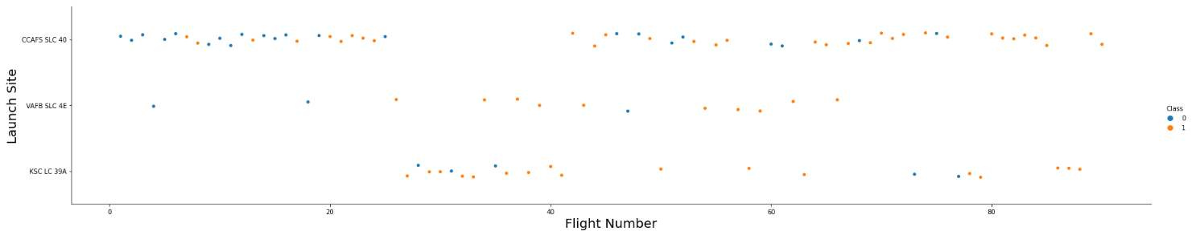
Flight Number vs. Launch Site
For these graphs, Class 0 (blue) means failure while Class 1 (orange) means a successful launch.
As flight numbers increased, so did the success rate.

Slide 19
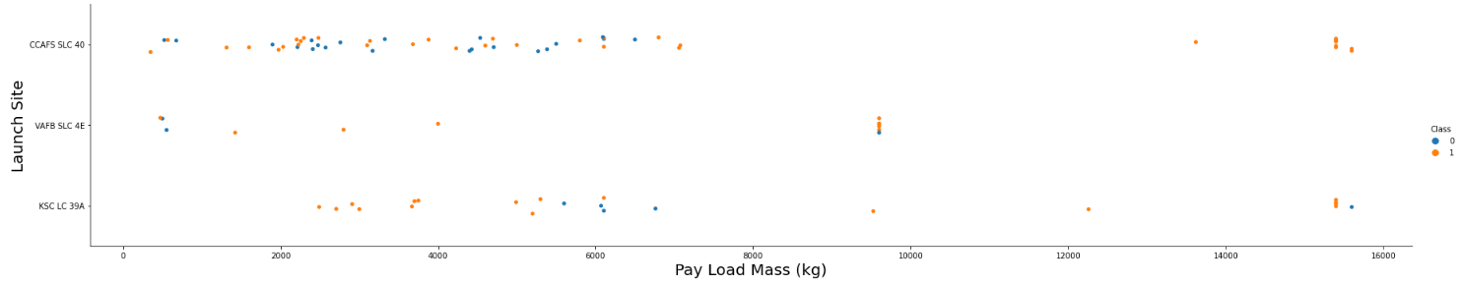
Payload vs. Launch Site
It can be seen that a payload mass of around 6,000 kg is not ideal for launch site KSC LC 39A.
It is also noted that once the payload mass gets above 7,000 kg, it yields much higher success rates as compared to the launches below 7,000 kg.

Slide 20
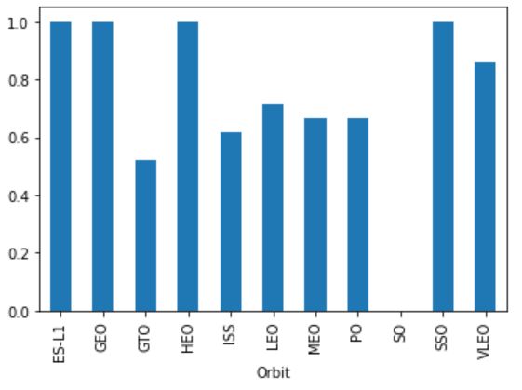
Success Rate vs. Orbit Type
For this bar chart, the data on the left-hand side is percentage, as in 1.0 equals 100%.
Noteworthy that Orbit “SO” did not yield any successful launches.
In a similar manner, four orbits only yielded successful launches [ES-L1, GEO, HEO, SSO]

Slide 21
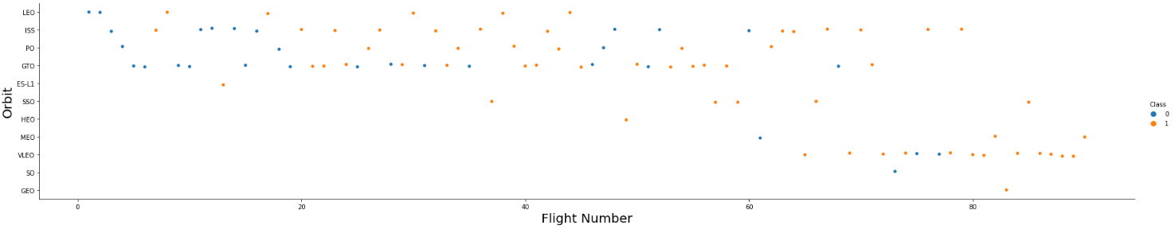
Flight Number vs. Orbit Type
This scatter plot shows some key information that lacked in the bar chart in the previous slide. Here you can see that orbits SO and GEO only had one launch each. Due to this, the success rate from these orbits have a very low trust level.
For most orbits, the success rate generally goes up with flight number, which has been a recurring theme in our data.

Slide 22
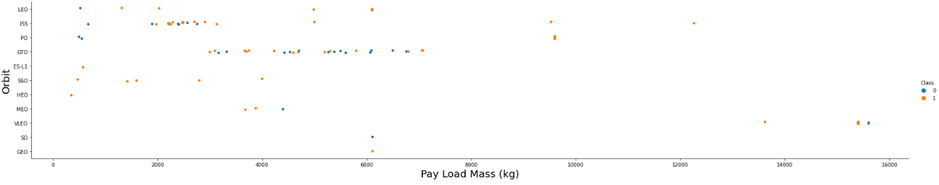
Payload vs. Orbit Type
This plot shows key differences between orbit types. A pay load mass below 2,000 kg is ideal for orbits ES-L1, SSO, and HEO. But it is the opposite scenario when it comes to orbits LEO, ISS, and PO.

Slide 23
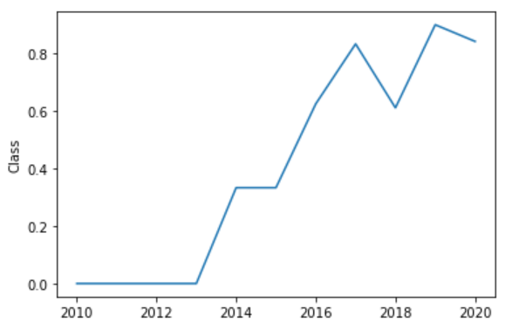
Launch Success Yearly Trend
As mentioned many times before, it can be seen here that as time goes on (i.e., flight number increases), the launch success rate tends to increase as well.
Logically this makes sense since more data would have been collected and technology advances made as time went on.

Slide 24
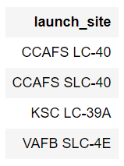
All Launch Site Names
Each launch site is shown in the table. This is accurate with the other data we have seen so far.
Code used…
%sql SELECT DISTINCT launch_site FROM SPACEXDATASET;

Slide 25
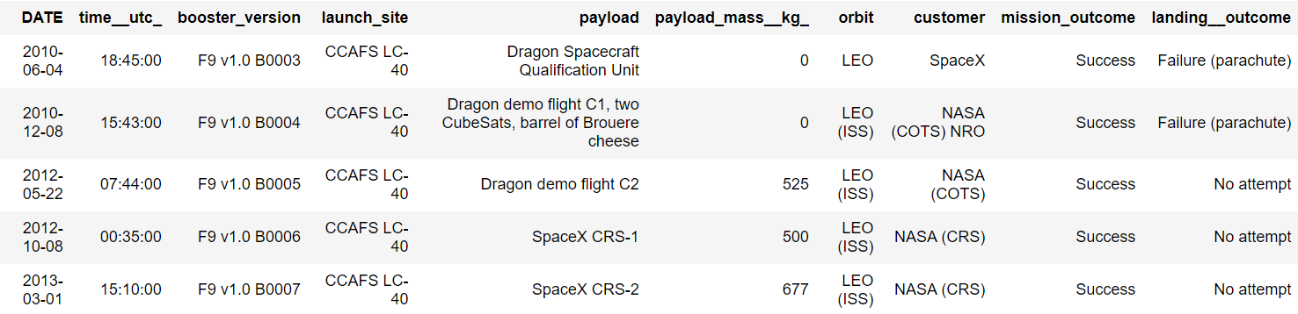
Launch Site Names Begin with 'CCA'
Below are 5 launches that had a launch site that started with “CCA”
Code used…
%sql SELECT * FROM SPACEXDATASET WHERE launch_site LIKE '%CCA%' LIMIT 5;

Slide 26
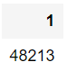
Total Payload Mass
The total payload carried by boosters from NASA was calculated.
Code used…
%sql SELECT SUM(payload_mass__kg_) FROM SPACEXDATASET WHERE customer LIKE '%NASA (CRS)%';

Slide 27
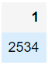
Average Payload Mass by F9 v1.1
The average payload mass carried by booster version F9 v1.1
Code used…
%sql SELECT AVG(payload_mass__kg_) FROM SPACEXDATASET WHERE booster_version LIKE '%F9 v1.1%';

Slide 28
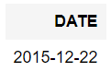
First Successful Ground Landing Date
The date of the first successful landing outcome on ground pad
Code used…
%sql SELECT DATE FROM SPACEXDATASET WHERE landing__outcome LIKE '%Success (ground pad)%' ORDER BY DATE LIMIT 1;

Slide 29
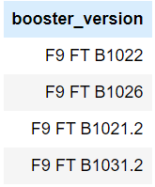
Successful Drone Ship Landing with Payload between 4000 and 6000
Names of boosters which have successfully landed on drone ship and had payload mass greater than 4000 kg but less than 6000 kg.
Code used…
%sql SELECT booster_version FROM SPACEXDATASET WHERE landing__outcome LIKE '%Success (drone ship)%' AND payload_mass__kg_ BETWEEN 4000 AND 6000;

Slide 30
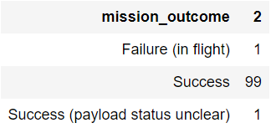
Total Number of Successful and Failure Mission Outcomes
Total number of successful and failure mission outcomes.
Code used…
%sql SELECT DISTINCT MISSION_OUTCOME, COUNT(*) FROM SPACEXDATASET GROUP BY MISSION_OUTCOME;

Slide 31
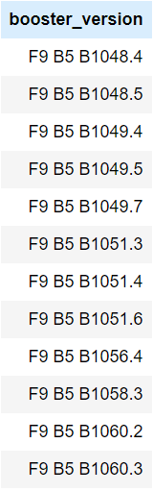
Boosters Carried Maximum Payload
Names of the boosters which have carried the maximum payload mass.
Code used…
%sql SELECT DISTINCT booster_version FROM SPACEXDATASET WHERE payload_mass__kg_ = (SELECT MAX(payload_mass__kg_) FROM SPACEXDATASET);

Slide 32
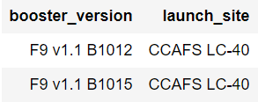
2015 Launch Records
The failed landing_outcomes in drone ship, their booster versions, and launch site names for in year 2015.
Code used…
%sql SELECT booster_version, launch_site FROM SPACEXDATASET WHERE landing__outcome LIKE '%Failure (drone ship)%' AND DATE LIKE '%2015%';

Slide 33
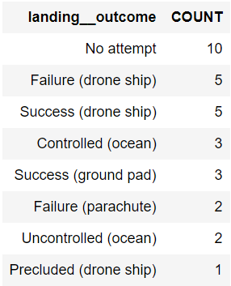
Rank Landing Outcomes Between 2010-06-04 and 2017-03-20
Ranking the count of landing outcomes in descending order.
Code used…
%sql SELECT LANDING__OUTCOME, COUNT(LANDING__OUTCOME) AS Count FROM SPACEXDATASET WHERE DATE BETWEEN '2010-06-04' AND '2017-03-20' GROUP BY LANDING__OUTCOME ORDER BY COUNT DESC;

Slide 34

Section 3

Slide 35
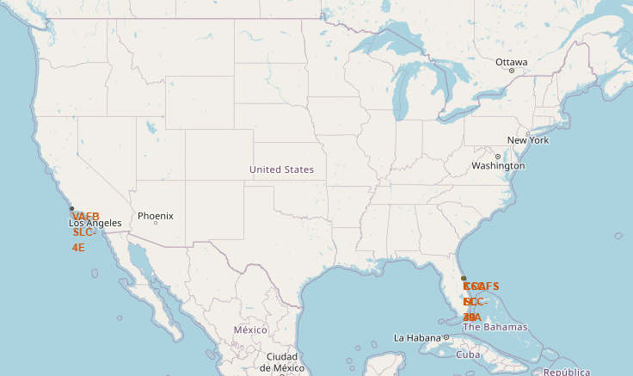
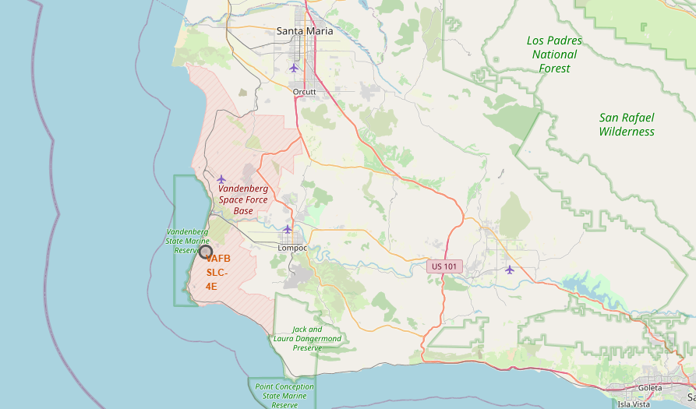
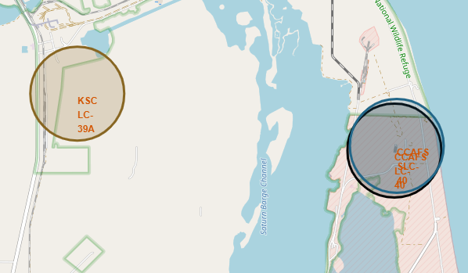
Adding Markers and Circles to Map
Here we can see a map of the launch sites.
Each launch site had a marker created for it.
In addition, a circle was formed around the marker to make it more noticeable. Each circle has a different color to clearly identify different launch sites.

Slide 36
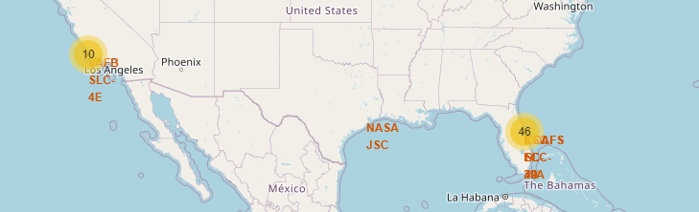
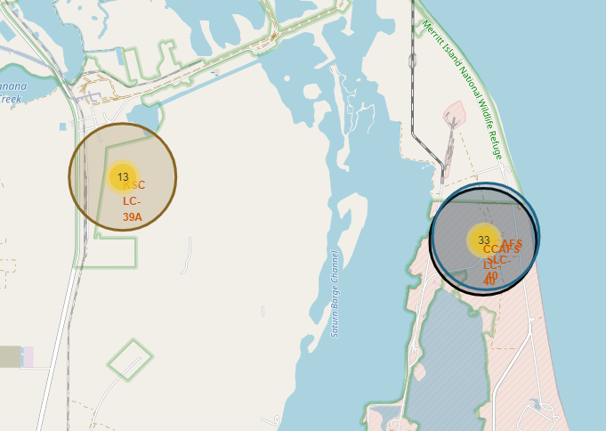
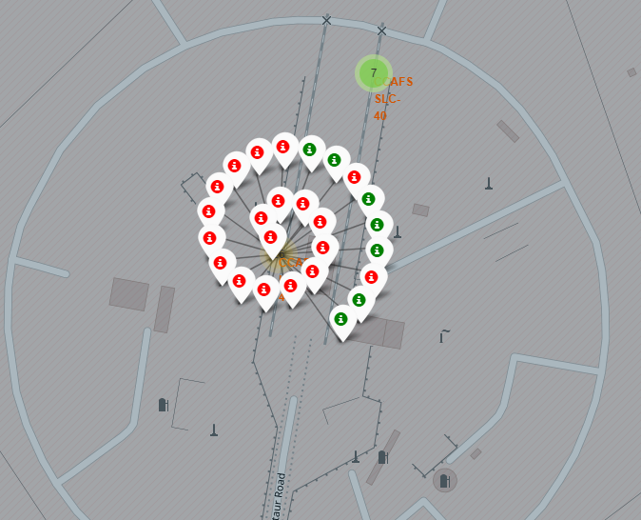
Map with individual launches
Then each launch was added to the map by site location.
These launches were also color coded, with red indicating a failed launch and green indicating a successful launch.
To access the individual launches, the user must zoom in on the map and click on the launch site.

Slide 37
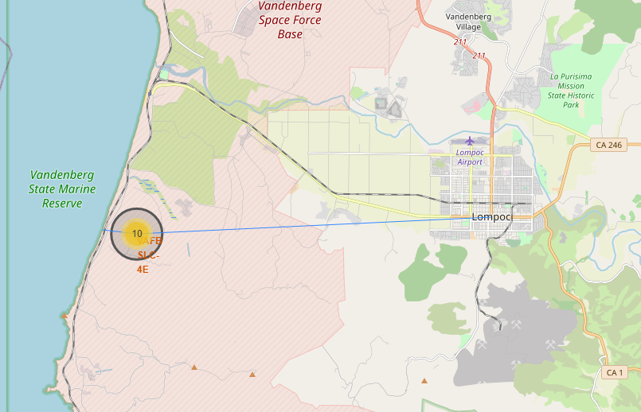
Map with proximity lines
Some new markers and lines were added to the map to indicate coastlines, cities, and railways near the launch site.
This can provide important safety information regarding the location of nearby areas occupied by people.

Slide 38

Section 4

Slide 39
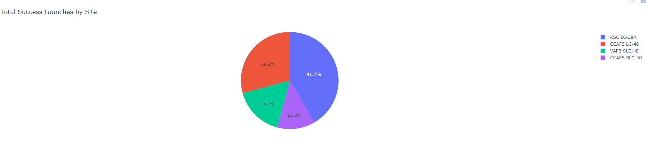
Successful Launches by Site
Replace <Dashboard screenshot 1> title with an appropriate title
Show the screenshot of launch success count for all sites, in a pie chart
Explain the important elements and findings on the screenshot

Slide 40
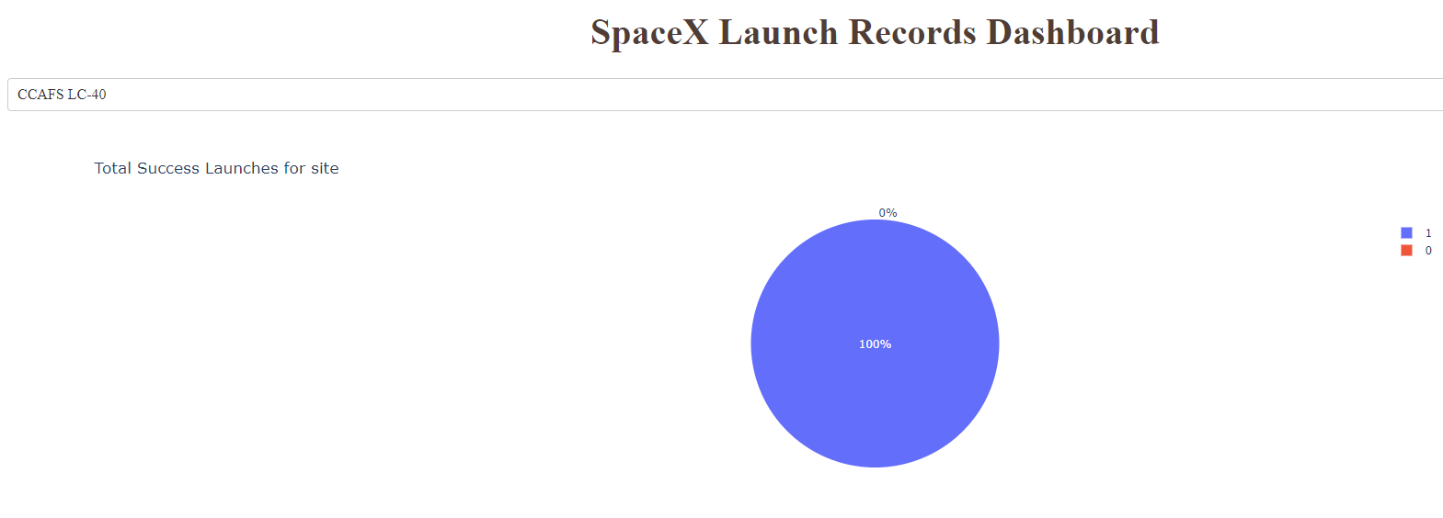
<Dashboard Screenshot 2>
Replace <Dashboard screenshot 2> title with an appropriate title
Show the screenshot of the piechart for the launch site with highest launch success ratio
Explain the important elements and findings on the screenshot

Slide 41
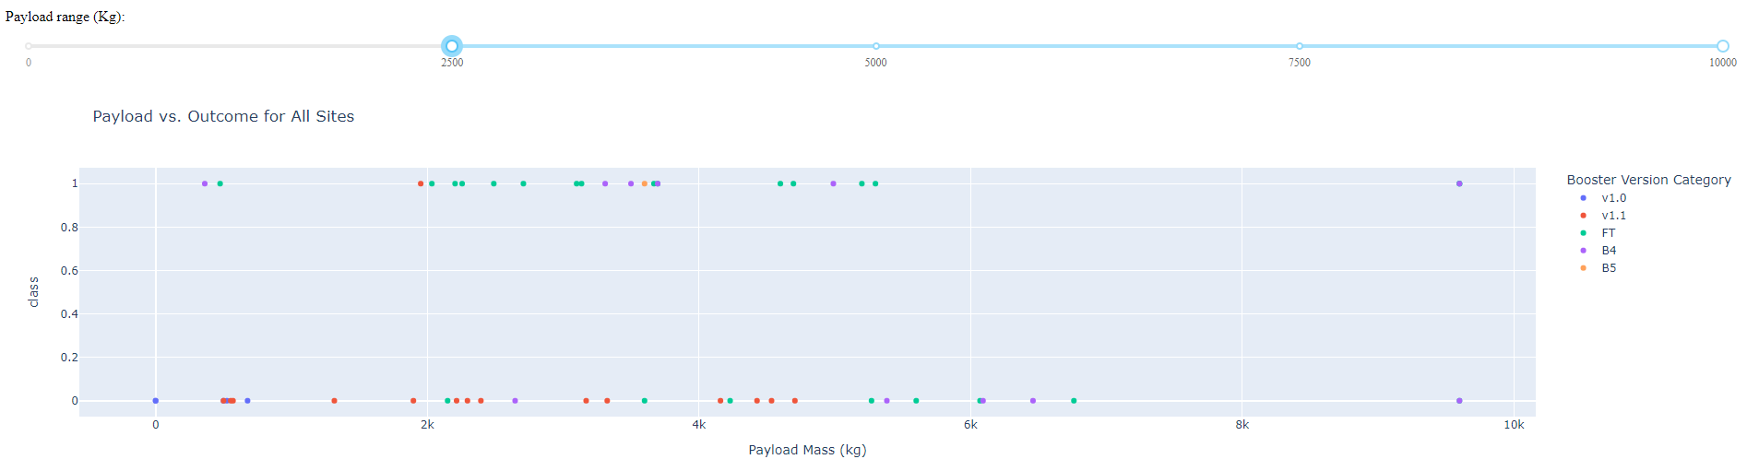
Payload vs. Outcome of All Sites
-Show screenshots of Payload vs. Launch Outcome scatter plot for all sites, with different payload selected in the range slider
Explain the important elements and findings on the screenshot, such as which payload range or booster version have the largest success rate, etc.

Slide 42

Section 5

Slide 43
Classification Accuracy
Visualize the built model accuracy for all built classification models, in a bar chart
Find which model has the highest classification accuracy
Model | Log | SVM | Tree | KNN
Train | 84.64 | 84.82 | 88.75 | 84.82
Test | 85 | 83.33 | 94.44 | 83.33

Slide 44
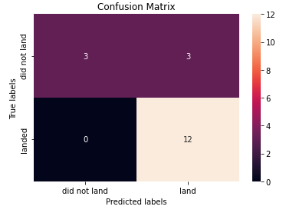
Confusion Matrix
Show the confusion matrix of the best performing model with an explanation

Slide 45
Conclusions
Point 1
Point 2
Point 3
Point 4
…

Slide 46
Appendix
Include any relevant assets like Python code snippets, SQL queries, charts, Notebook outputs, or data sets that you may have created during this project

Slide 47


